Slide 1

Wasalni
We are differently able

Slide 2
Introduction
Our company Wasalni is a transportation company that aims to help people with special needs and facilitate their transportation.
Our main purpose is to create an appropriate environment where our clients feel relieved and do not feel any difference. For we believe that we are differently able.

Slide 3
01
Planning function
02
Organizing function
03
Influencing function
04
Controlling function

Slide 4

Planning function
Objectives:
Short-term objective
Intermediate-term objective
Long-term objectives
List of alternative ways of reaching objectives
First Idea
second Idea
third Idea
The best alternative for reach objective
Develop plans to pursue chosen alternative
Put plans into action

Slide 5

Organizing function
establish major tasks:
divide major tasks into subtasks
privacy and policy department
technology department
human resources department
customer support department
finance department
marketing department

Slide 6
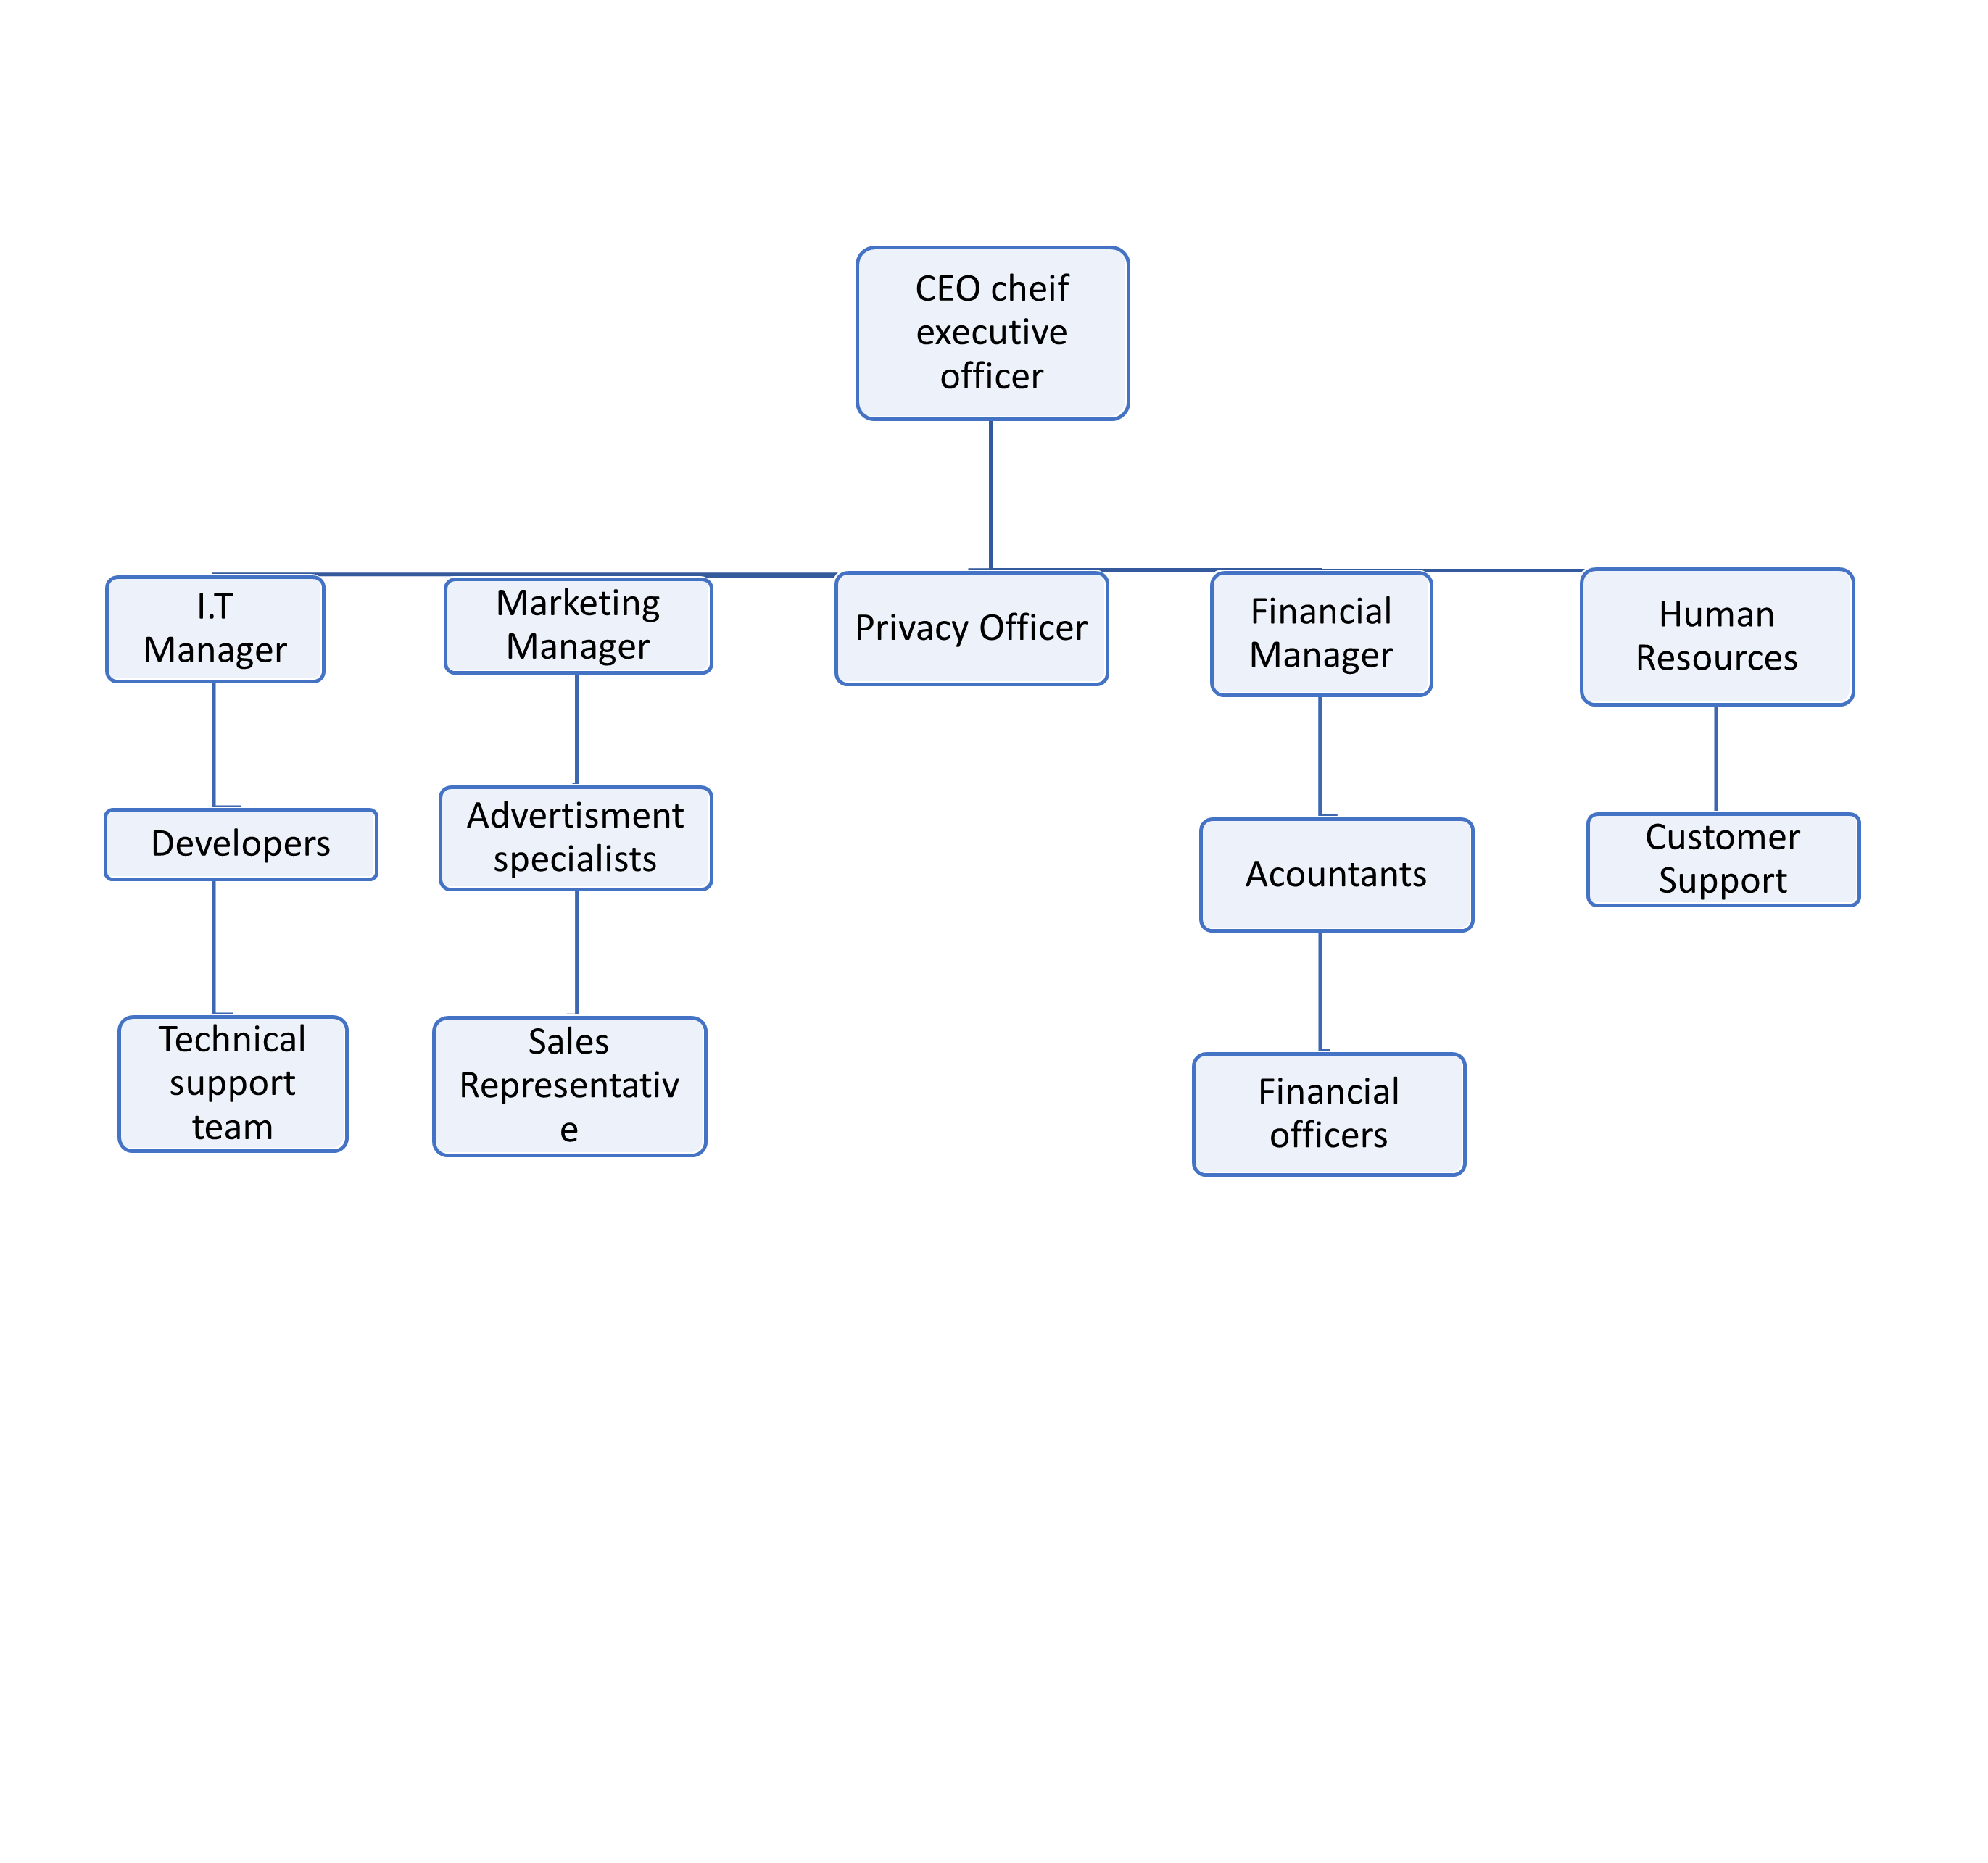
Division of labor

Slide 7
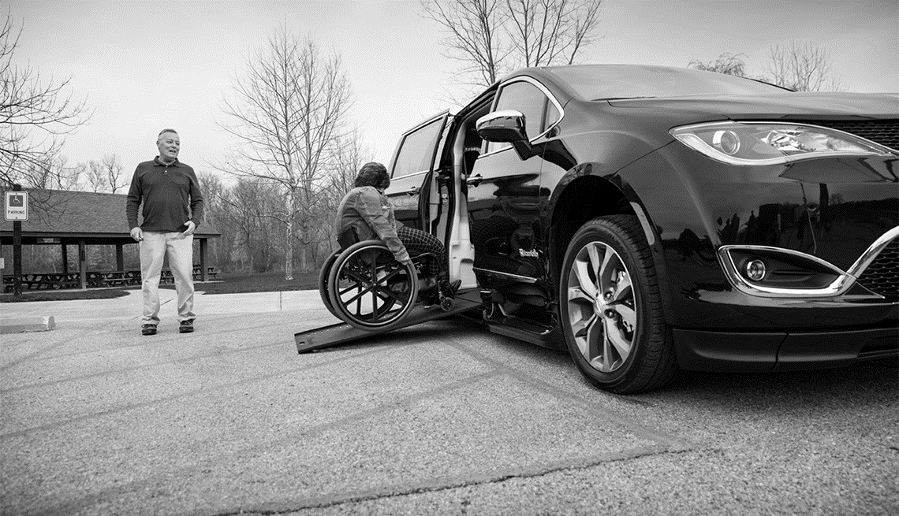
Influencing function
inputs
processing
output
emotional intelligent manager

Slide 8

Controlling function
Standard of ideas:
First Idea
second Idea
third Idea
Actual performance of ideas:
First Idea
second Idea
third Idea
Corrective ideas

Slide 9
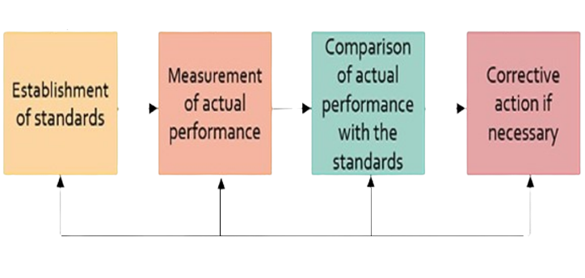
Step I
Step II
Step III
Step IV
feedback

Slide 10
Prepared by
Name ID
Monica saeed habeb 20200567
Michael Maher Nagi 20200576
Mira Ehab Mikhail 20201234
Mirette Shenouda Maher 20200575
Catherine Ramy Mikhail 20200386
Youstina Sadawy Thabet 20200686
Andrew Ashraf Samuel 20201036
Fady Emeel Abdelmassih 20200370

